Slide 1

DORY - Mission Overview
TEAM Politecnico DI MILANO
ESA/ESEC (Concurrent Engineering Challenge 2025)

Slide 2
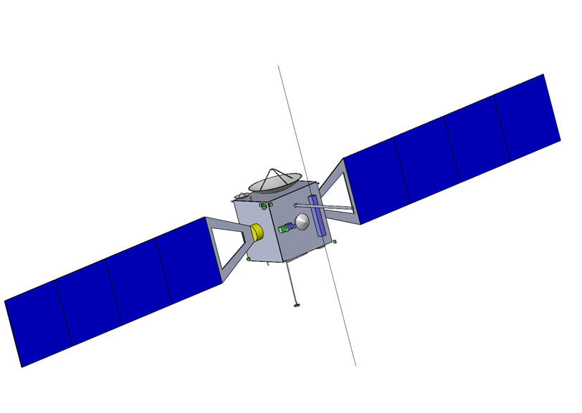
Mission Overview
GOAL
Study comet shape and mass distribution
Map the surface of a comet
Investigate the in-depth composition
To mesure the on-site magnetic disturbances
Return at least 10g of samples on Earth
Target Comet: 304P/ORY
Mass | 3643.81 kg
Margined ∆V | 2581.32 m/s
Dimensions | 3.82 x 3.05 x 2.92 m

Slide 3
Architecture selection
MONOLITHIC SATELLITE
Simpler
Lighter
Touch and Go strategy
Cheaper
Less critical events
SATELLITE + LANDER
More complex
Heavier
Landing strategy
More expensive
Lower TRL for in-situ PL
Criterion | Monolithic satellite | Satellite + Lander
Mass | 5 | 4
Science Output Depth of sampling | 4 | 5
Science Output Mass of sample | 5 | 4
Cost | 5 | 3
Reliability | 3 | 2
Trade-Off analysis (5 is best)
MONOLITHIC SATELLITE

Slide 4
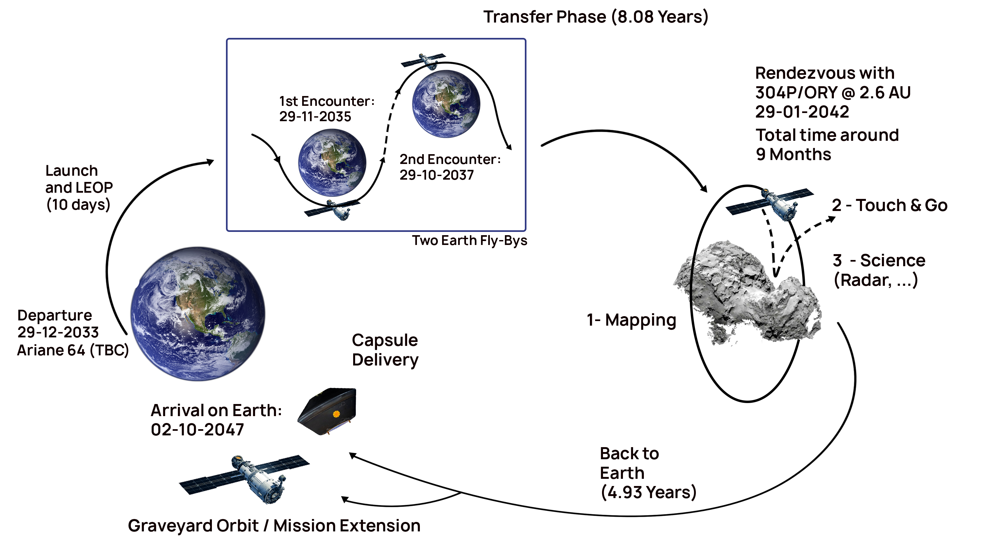
CONOPS

Slide 5
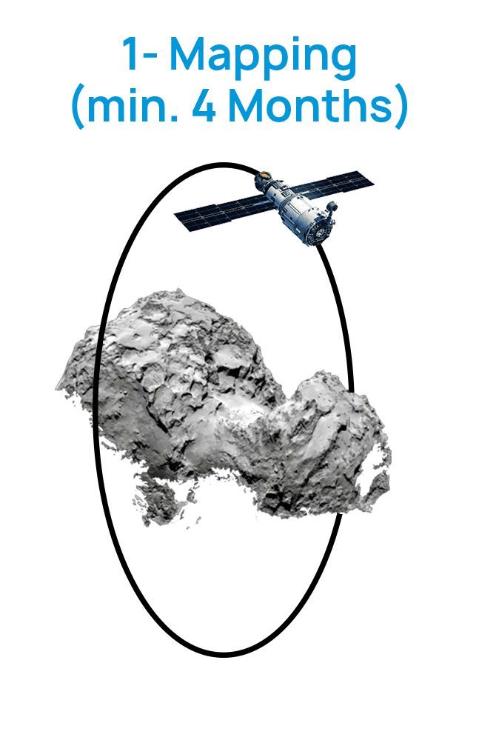

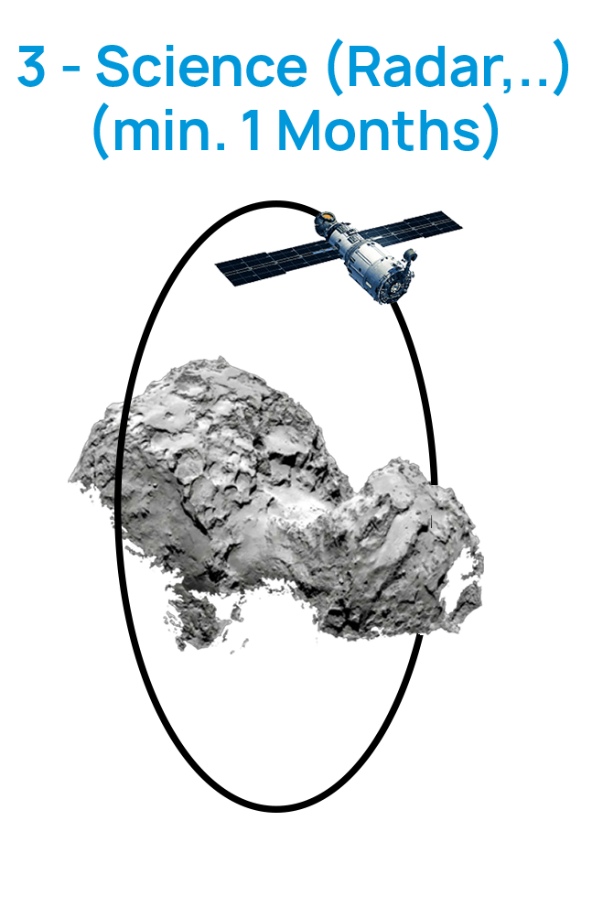
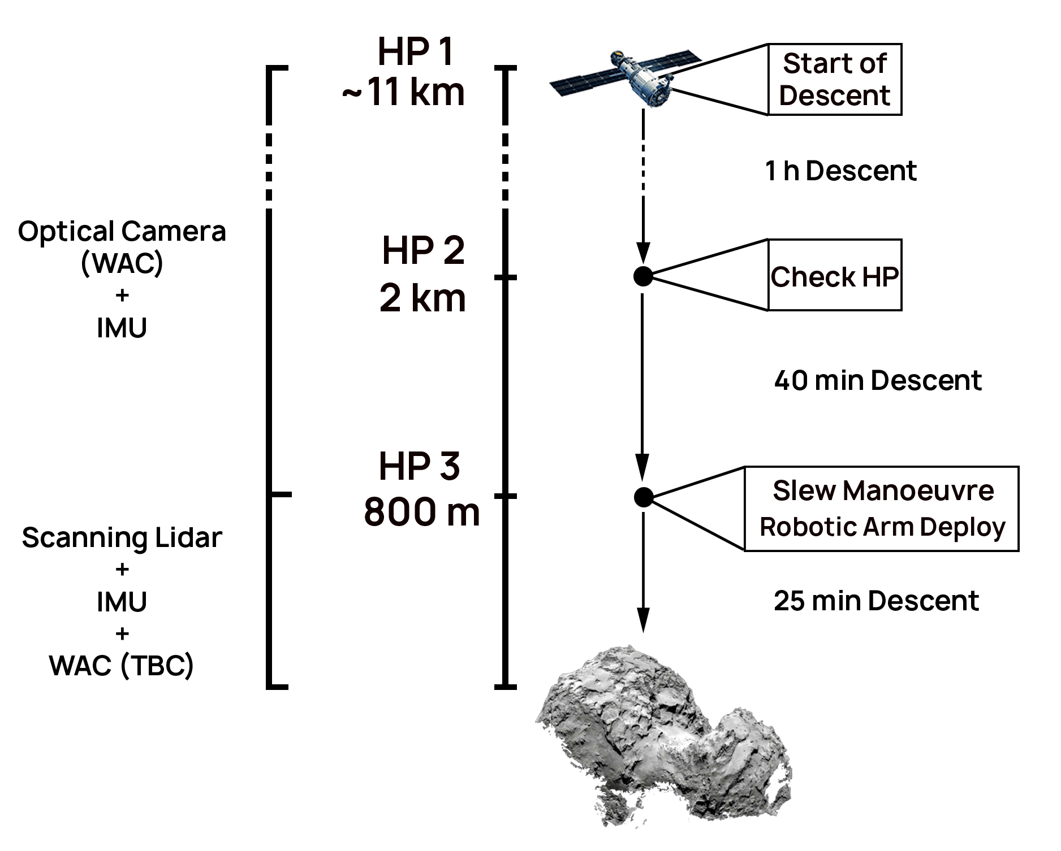
CONOPS
HP: Hold Point

Slide 6
Modes
Modes | Definitions
Science - Remote | Mapping of the comet
Science - TAG | Touch and Go
Science – Rad-Mag | Comet study with radar and magnetomer
Maneuver - DSM | Deep space maneuver
Maneuver - OCM | Orbital correction maneuver
Telecom - LP | Low power telemetry communication
Telecom - HP | Science data downlink
Transfer | Interplanetary transfer
Safe | Power saving mode
Detumbling | Reduce s/c angular rate
Approach | Approach to the comet
Desaturation | Desaturation of the reaction wheels
Commissioning | Testing of all the subsystems

Slide 7
Payload Paolo Fedele Di Giglio Gabriele Farina Matteo Fulgheri Moein Peyghambarzadeh

Slide 8
Requirements and Assumptions – Payload
REQ ID | STATEMENT
MR-03 | The mission shall return at least 10g of samples to Earth.
MR-04 | The mission shall investigate the elemental composition of a comet to at least a depth of 30cm (requirement), and should investigate a depth of up to 1m (goal).
MR-08 | The mission shall investigate the elemental composition of 100% of the surface of a comet with a resolution of 2m.
SR-05 | The system shall allow for the identification of at least one landing site.
SR-10 | The system shall be able to monitor and provide data of magnetic disturbances in 3 axes.
Input from MA
The semi-major axis during surface mapping is 10 km.

Slide 9
Analysis and Trade-offs – Payload
Sample Collection
Landing vs Touch&Go approach
Projectile vs Gas
Sample Conservation Analysis
Comet Enviroment Analysis
Depth Investigation
Drill sampling vs Remote observation
SAR vs Radar Sounder
Mass, power and data budgets
Vertical resolution
Time of Observation
Surface Mapping
Camera properties (FOV, spatial resolution)
Mass & Power Budgets
Time of Observation
Altitude analysis
Notes:
Most critical requirement -> MR-04
Analyze internal structure of the comet through radar sounder instead of direct sample collection.
Dielectric properties + mass distribution = geological structure.
--> Talk about Time/# acquisition/data volume for radar

Slide 10
Final Baseline Design – Payload
Camera resolution: 93.7 µrad
Camera FOV: 5.5 x 5.5 deg
Camera wavelengths: 400-1050 nm
RADAR frequency: 20 Mhz
MAG resolution: 0.047 nT
Instrument | Req ID | Mass + DMM [kg] | Power [W] | Data Rate | Data Volume
Framing Camera (DAWN) | MR-08 SR-05 | 5.775 | 17 | 20.5 Kbps | 10.3 GB
Radar (SHARAD MRO) | MR-04 | 17.955 | 28 | 20 Mbps | 10 GB
Magnetometer (MESSENGER) | SR-10 | 1.50 (boom 2.8) | 4.2 | 0.414 Kbps | 267 MB

Slide 11
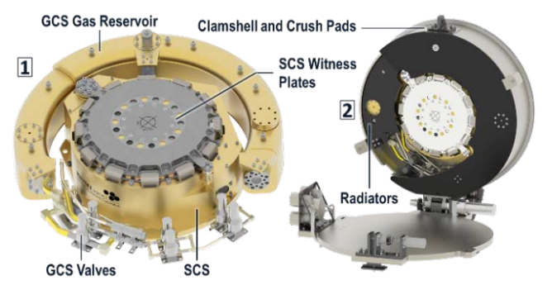
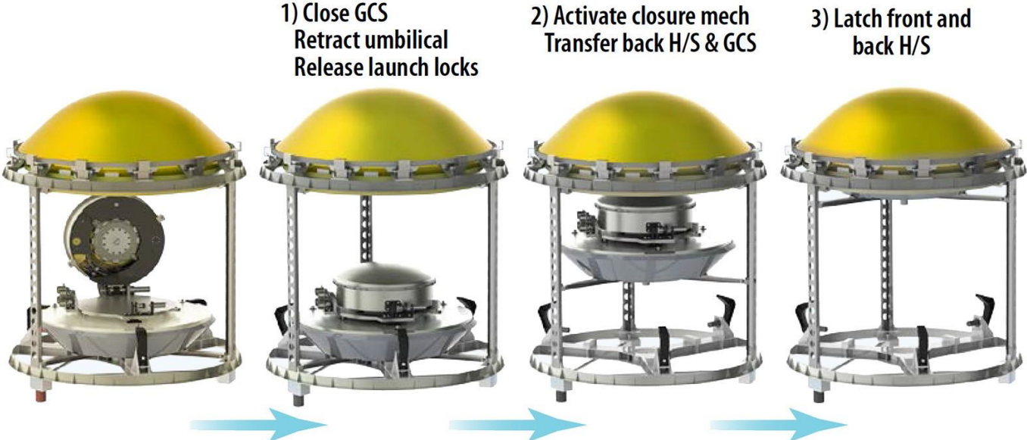
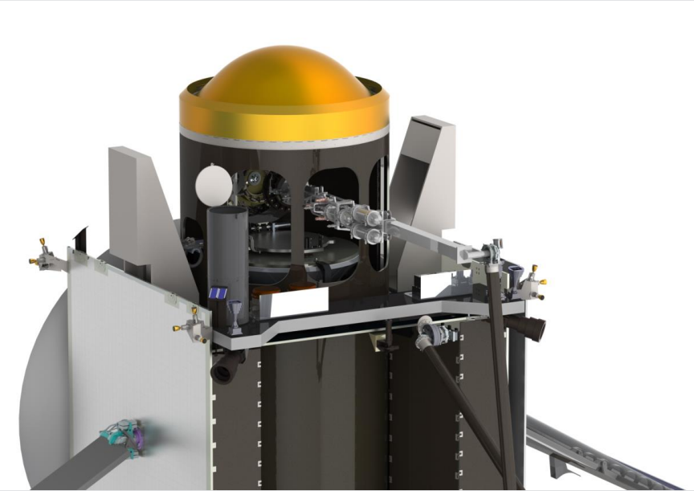
Final Baseline Design – Payload
GCS & SCS concept from CAESAR mission
Sample Return Capsule Closure
Sample container stow in SRC
 | Temp. [°C] | Pressure [Pa]
*GCS | <- 80 | <500
**SCS | <- 60 | Vented
Decoupling volatile/solid
Temperature/pressure conditioning
*GCS = gas containment system
**SCS = solid containment system
Notes:
Possible to use the same approach of the CAESAR concept Sample Return Capsule, passive cooling system.
Volatile & Solid separation.
Sublimation transfer of volatile components to GCS is made by a complex mechanism of slowly warming up.

Slide 12
Mission Analysis Davide Bellini Alessandra Centrella Francesco Persenico Davide Provenzi

Slide 13
Requirements and Assumptions – MA
CRITICALITIES
STATEMENT
Multi Gravity Assist trajectory needed to rendezvous with the comet.
Constraints to perform science at distances from the Sun lower than 3AU.
ASSUMPTIONS
STATEMENT | COMMENTS
No drag is considered during the close proximity Phase | Low activity of the comet when this phase occurs
Impulsive manoeuvres
5.5 km/s v∞ given by launcher | May exceed Ariane 64 capabilites

Slide 14
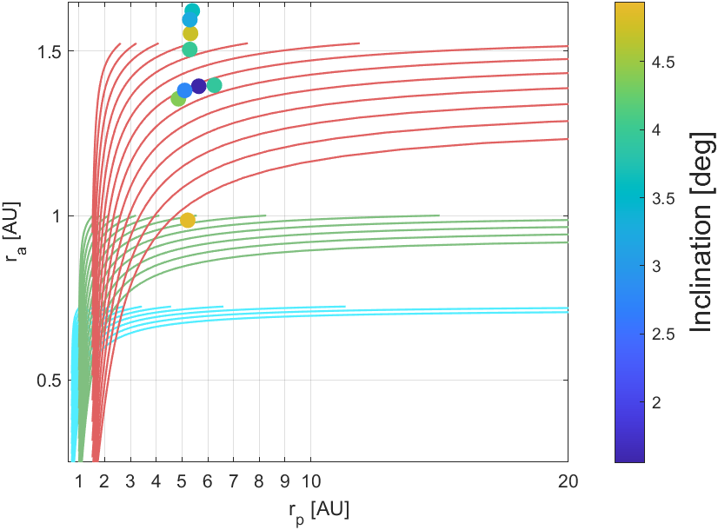
Analysis and Trade-offs – MA
304P/Ory
184P/Lovas 2
Comet identification:
Jupiter family comets
Condition code = 0 (Uncertainty knowledge)
i < 10°
Perihelion radius (rp): 1.08 < rp < 1.7 [AU]
Flyby sequence analysis:
Tisserand graph e flyby selection
Close Proximity:
Safe approach to the comet
Imaging condition
320P/McNaught

Slide 15
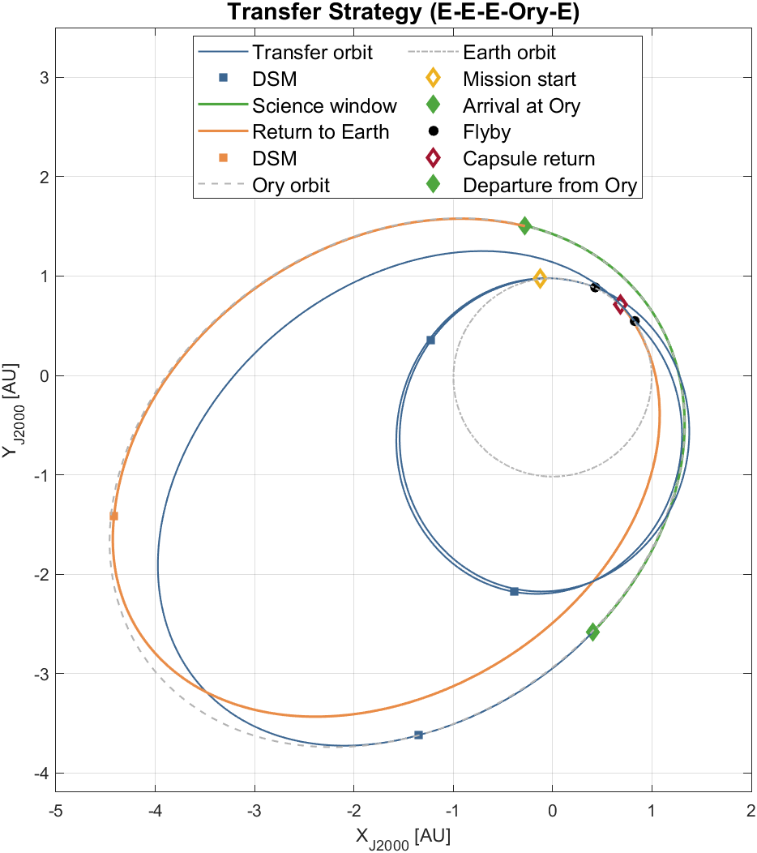
Transfer strategy – MA
Approach:
PyKep and Pygmo libraries
Multiple runs of the heuristic +slsqp solver
Solution:
Transfer to Ory
Departure from Earth: 2033-Dec-29
3 DSMs and 2 Earth gravity assists
Rendevouz with Ory: 2042-Jan-29
∆V = 1.430 km/s
Return to Earth
Departure from Ory: 2042-Dec-04
DSM near the orbit apocenter
Capsule release and Earth divert
∆V = 0.785 km/s

Slide 16
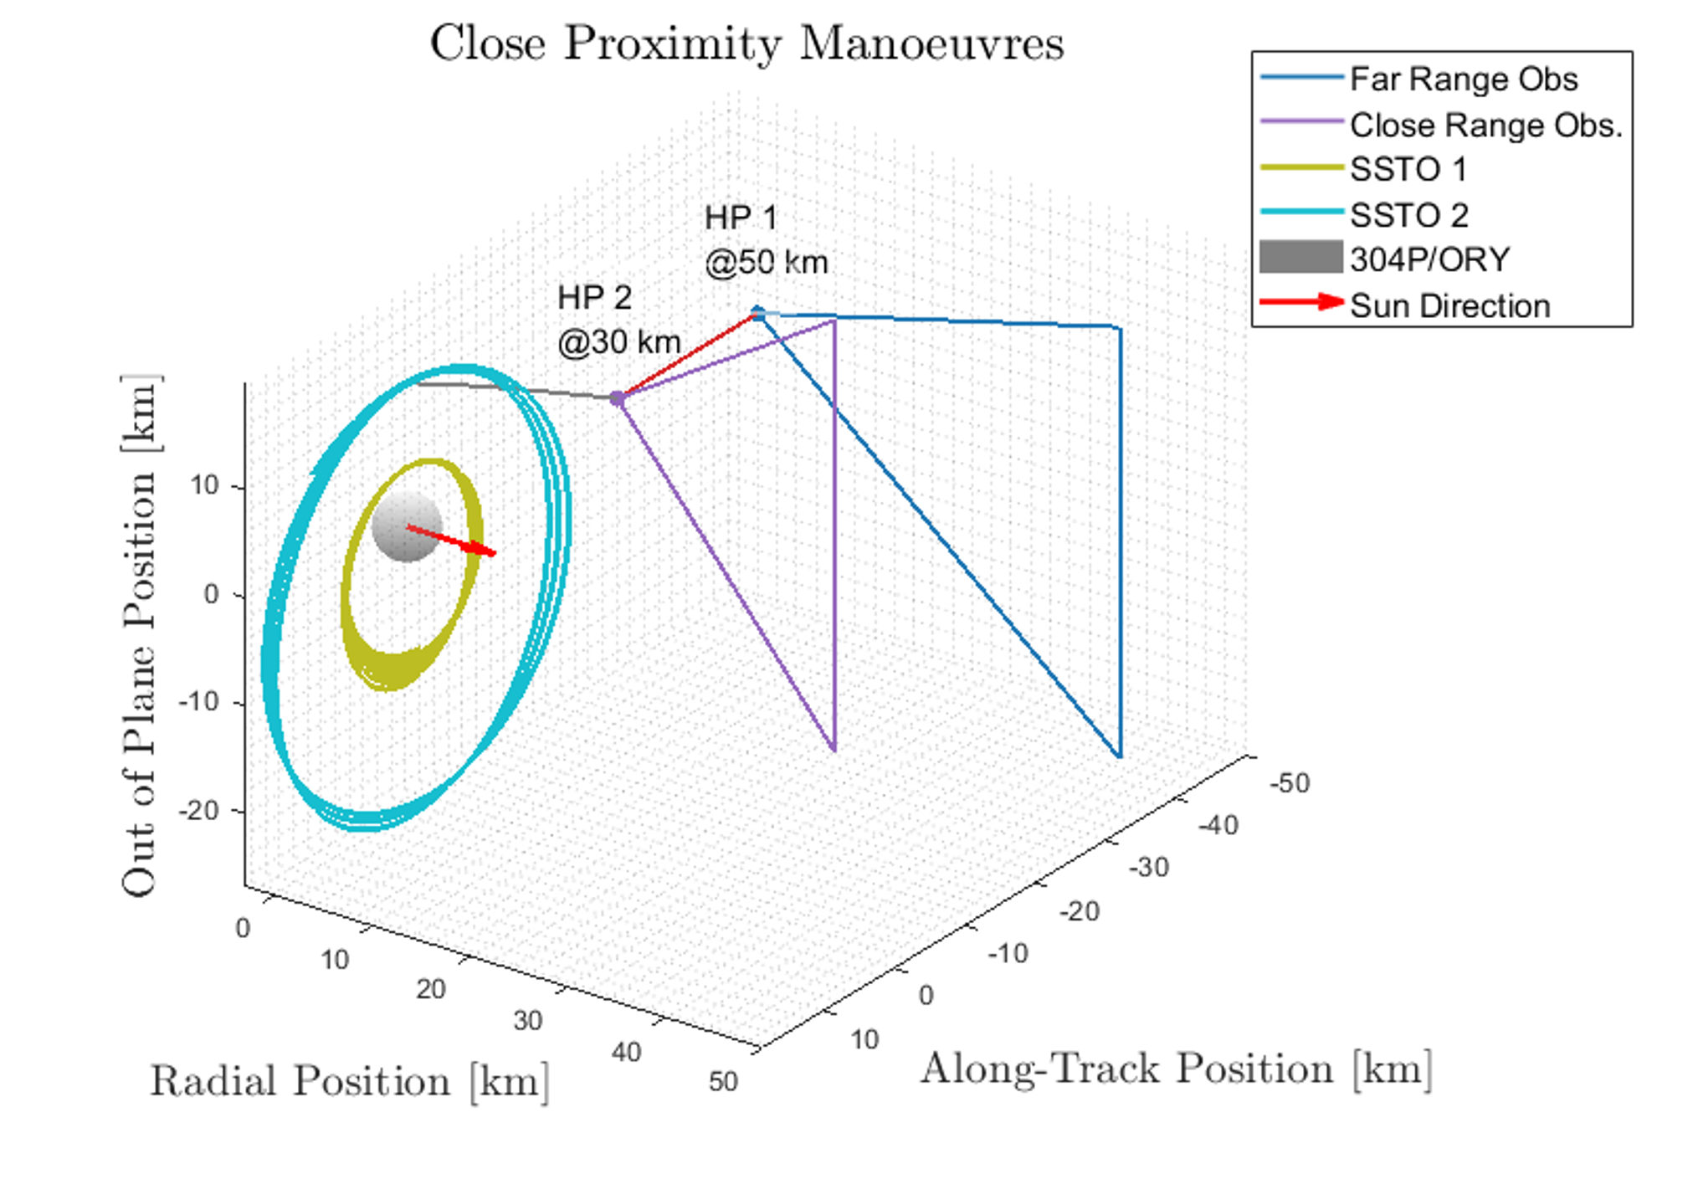
Close Proximity - MA
Initial Target Characterization
Approach along track for safety reason
(quasi stable HP)
Sun phase angle span (40° - 90°) for
optimal imaging condition
Target Mapping
2 Sun Stabilized Terminal Orbits (SSTO) for mapping
2 Altitude levels for safety reasons
Backup: equatorial orbit if spin axis is unfavourable
Total ∆v < 100 m/s
SSTO 1, a = 10 km
SSTO 2, a = 20 km

Slide 17
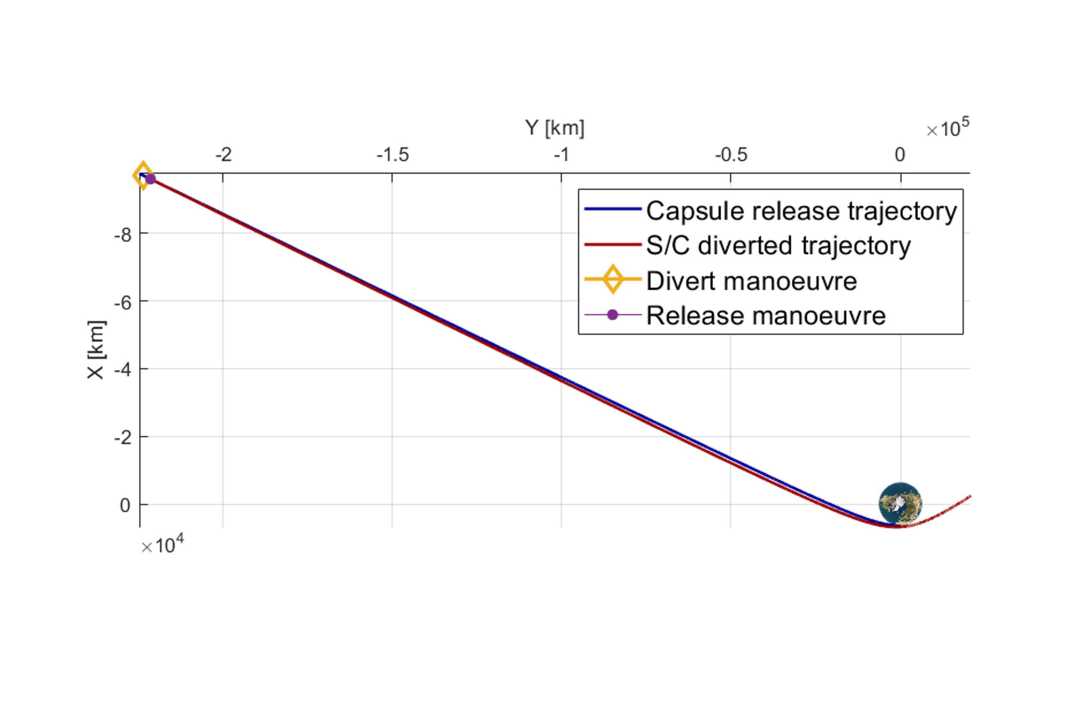
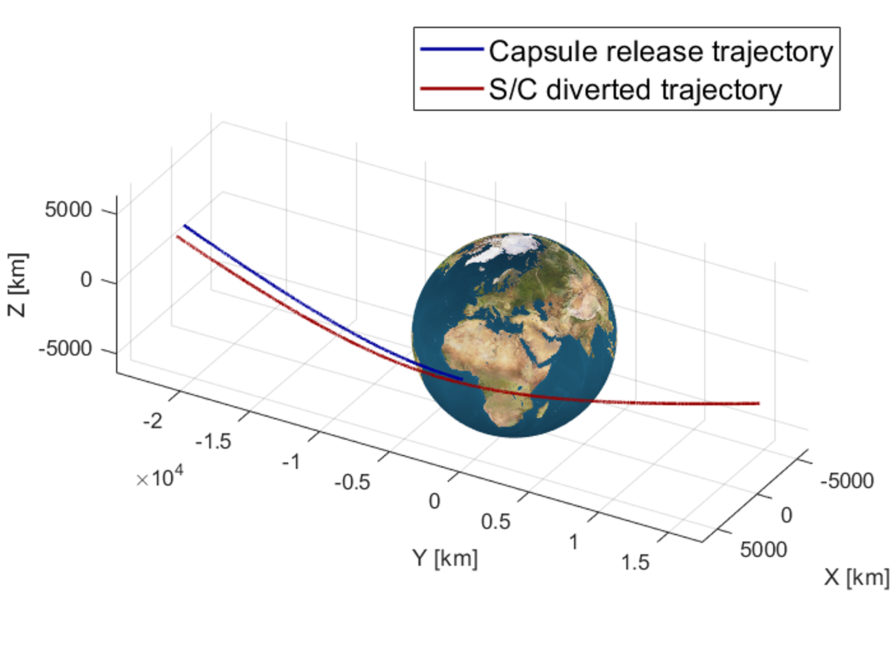
Capsule release and divert manoeuvre - MA
Capsule release:
12h before re-entry
Hyperbolic pericentre on Earth surface
Divert manoeuvre:
Right after capsule release
Pericentre raising to 400 km
Earth escape
Terminal guidance
End of Life (TBD):
Heliocentric graveyard orbit
Mission extension

Slide 18
DV Budget – MA
MANOEUVRE | ∆V [m/s] | Margin | Margined ∆V [m/s]
LAUNCH-COR | 30 | 0 | 30
DSM 1 | 0.01 | 10 m/s | 10.01
TCM-FB 1 | 35 | 0 | 35
DSM 2 | 474.43 | 5% | 498.16
TCM-FB 2 | 35 | 0 | 35
DSM 3 | 788.61 | 5% | 828.04
TCM-REND | 10 | 0 | 10
COMET-REND | 167 | 5% | 175.35
PROX-OPS | 50 | 100% | 100
COMET-DEP | 42 | 5% | 44.1
TCM - EARTH | 35 | 0 | 35
DSM - 4 | 709 | 5% | 744.96
EARTH-DIVERT | 34 | 5% | 35.70
TOT | 2410.54 | - | 2581.32
LAUNCH-COR: Launch correction manoeuvre
DSM: Deep Space Manoeuvre
TCM: Trajectory Correction Manoeuvre
FB: Fly-By
COMET-REND: Comet rendezvous

Slide 19
AOCS/GNC Francesco Cataffo Marco Cocomazzi Daniele Paternoster

Slide 20
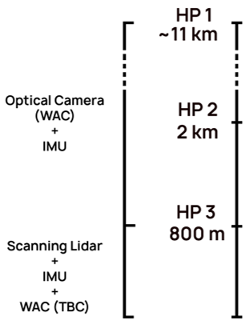
Requirements and Assumptions – GNC
CRITICALITIES
REQ ID | STATEMENT | COMMENTS
GNC-010 | The dynamics of the comet shall be characterized during approach phase.
GNC-020 | Landing Precision wrt to the selected one | From MR or SR, influences
GNC-030 | Landing Velocity | From structure subsystem
GNC-040 | The approach from HP3 to touch-down shall be performed in autonomy. | From TTMTC to ensure the proper utilization of HGA
Sensors sensibility to dust → operations.
Not all hazard are detectable from nominal orbit (SSTO at 10km) → HPs at lower altitude.
Autonomous from HP3 to touchdown → too high TC delays for real time ops.
Minimize the T&G time (from EPS) → full thruster usage.
ASSUMPTIONS
HP: Hold Point
STATEMENT | COMMENTS
Absolute navigation: DDOR ang. accuracy 10nrad | From literature
No drag is considered during the Approach to Landing Phase | Low activity of the comet when this phase occurs
Impulsive manoeuvres
STATEMENT | COMMENTS
Sensor sensibility to dust | Low activity of the comet when this phase occurs
Not all hazard detectable from the nominal orbit (SSTO 10 km) | HPs at lower altitude are employed to detect eventual hazard
Autonomous HP3 to Touchdown | Too high telecommunication delays for real-time ops.
Safety, visibility, deploy robotic arm (HP3)
Minimize the T&G time | To reduce the battery size

Slide 21

Navigation – GNC
Analysis and trade offs:
Interplanetary navigation – ground based:
Range measurement: very accurate (≈10m).
DDOR: angular measurement (≈10nrad accuracy).
Range rate measurement: very accurate (≈10mm/s).
Relative navigation:
Optical Camera → navigation around the comet and for navigation for landing up to HP3, support mapping imaging.
Scanning lidar → navigation for final landing phase (T&G) with dust.
IMU → robustness.
Baseline design:
Scanning lidar
Wide Angle Camera (60° FOV) → full comet in FOV @h=10km
IMU
DDOR + Range Rate measurement + Range (TBC)
}
Relative
Interplanetary

Slide 22
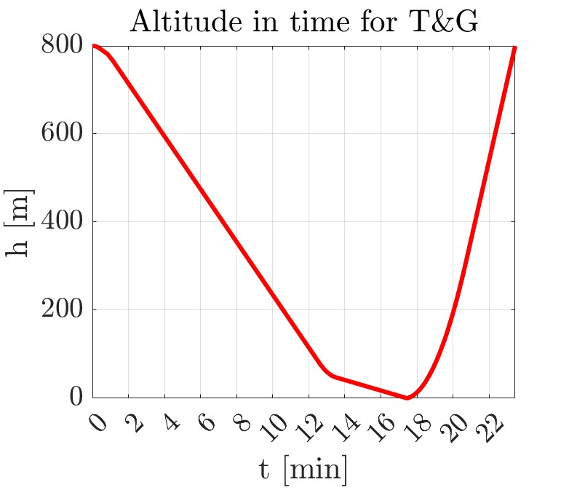
Touch & Go strategy – GNC
Constraints:
V_{touch} = 0.2 m/s
h_{approaching}= 800 m
Minimize T&G time
F_{THmax} = 12 N
}
V_{coast}=1 m/s
}
Full thruster usage
Approach:13.5min Coasting: 3.9min
Impact:5.8s Escape: 5.9min

Slide 23
Requirements and Assumptions – ADCS
MAIN REQUIREMENTS
REQ ID | STATEMENT | COMMENTS
ADCS-010 | The spacecraft shall not exceed a maximum angular acceleration of 0.17 °/s² | From structural and payload request
ADCS-020 | The subsystem shall be designed to ensure single-failure tolerance | System requirement [SR-01]
ADCS-030 | During remote science mode, the APE shall not exceed 0.1° | From PL requirement, resulting in worst APE for the whole mission
ADCS-040 | During safe mode, the APE shall not exceed 5° | From TTMTC to ensure the proper use of LGA
MAIN ASSUMPTIONS
STATEMENT | COMMENTS
No drag is considered during the Approach Phase | Low activity of the comet when this phase occurs
SRP was considered referring to 1 AU | Closest distance to Sun during whole mission
AKE is assumed to be 1/3 of the APE at each mode | Common best practice in mission design
Slew sizing based on a 180° rotation in 20 minutes | From worst case of angle and time across operations

Slide 24
State Machine and modes – ADCS
DESATURATION
DETUMBLING
ORBIT CONTROL
TRANSFER
COMMUNICATION
SUN POINTING
COMMISSIONING
SCIENCE - touch
SCIENCE - remote
GS commanded
GS commanded or Automatic
SAFE
Automatic
Failure Detection
Notes:
In the following slide is presented the state machine for ACDS. There are 9 nominal modes plus the safe one. The transition can be either ground station commanded or automatic, whereas whenever a failure is detected there is the transition to safe mode

Slide 25
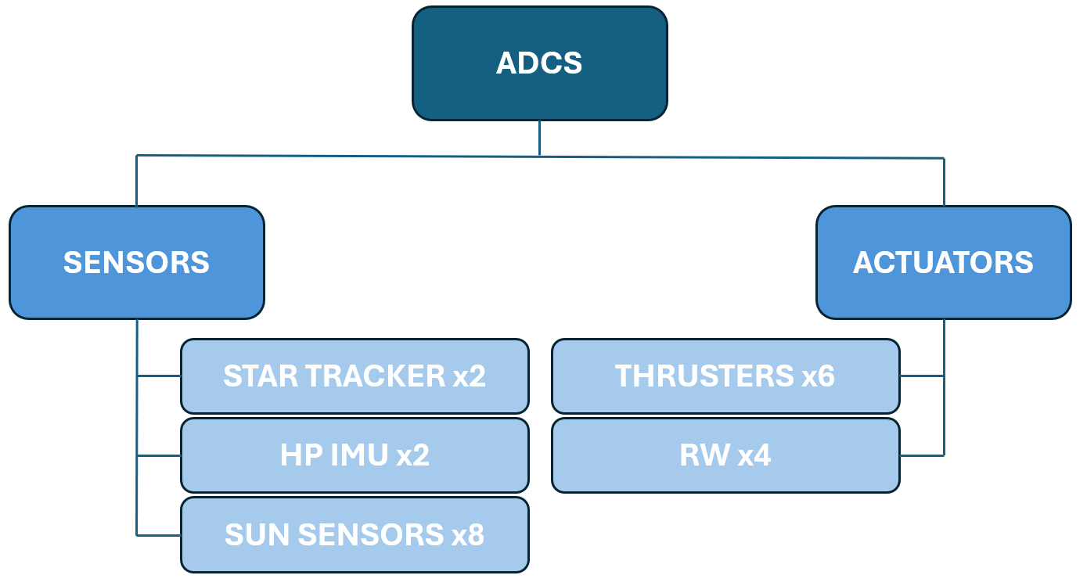
Trade-offs and baseline architecture– ADCS
TRADE-OFFs
RWs are more efficient than CMGs
Common thrusters with PS
Star Tracker integrity: positioning as far away as possible from landing surface
BASELINE
2 Star Sensors
2 IMUs
8 Sun Sensors
4 RWs
6 Thrusters
Cold redundancy
Retrieve attitude in worst case scenario (no star trackers available)
To have almost full coverage
Pyramidal configuration
Avoid residual torques, most control authority along non vertical axis while landing
Notes:
In this slide are presented the criticalities met during the desig. During the mission, no high slew rate is required and also considering our mass Reaction wheels are more efficient than CMGs. Another critical point is the configuration of thrusters: the chosen one allows to use common thrusters with propulsion system in order to reduce the number needed. Next inmportant point from requirements is the redundancy. We opted for 2 Star trackers used in cold redundancy in order to have one always available when the other has sun in field of view. Than there are 2 IMUs that in terms of redundancy are needed to allow the retrieving of attitude whenever star sensors are not available. Moving to Reaction wheels, a pyramidal configuration was chosen in order to have always full controllability. Finally we conclude with 6 thrusters to which we add two from PS: the total amount allows to avoid residual torques along each of the three axis

Slide 26
Propulsion Riccardo Coppola Gabriele Nuccio Angelica Perniciaro

Slide 27
Requirements and Assumptions – PS
REQ ID | STATEMENT | COMMENTS
PS-01 | The system shall ensure the total ΔV of the mission. | To comply with Mission Analysis.
CRITICALITIES
Provide a compact system compatible with mission analysis.
Design a system requiring an affordable power budget.
ASSUMPTIONS
STATEMENT
Statistics used for Pressure Falls from the Tanks to the combustion chambers.
Thrusters were taken from COTS.
Final Helium pressure equal to tanks pressure.

Slide 28
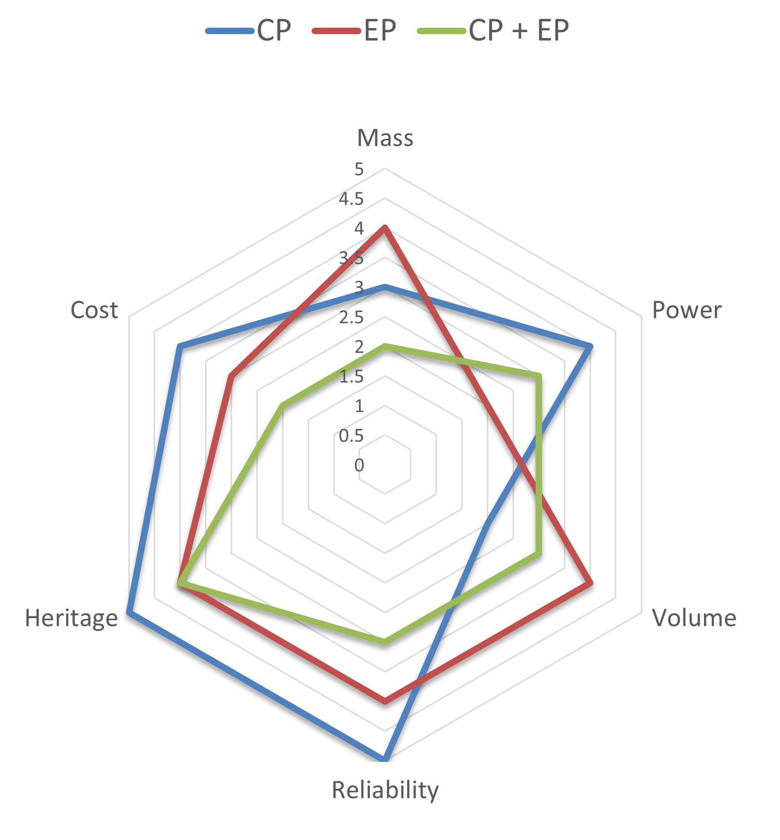
Analysis and Trade-offs – PS
3 Alternatives for the main propulsion system:
CP: Bipropellant/Monopropellant
EP: Xe Ion thrusters
CP + EP

Slide 29
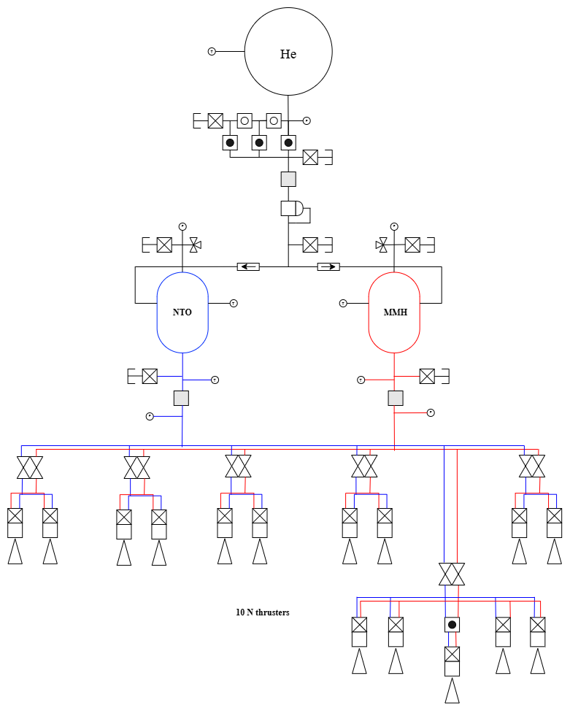
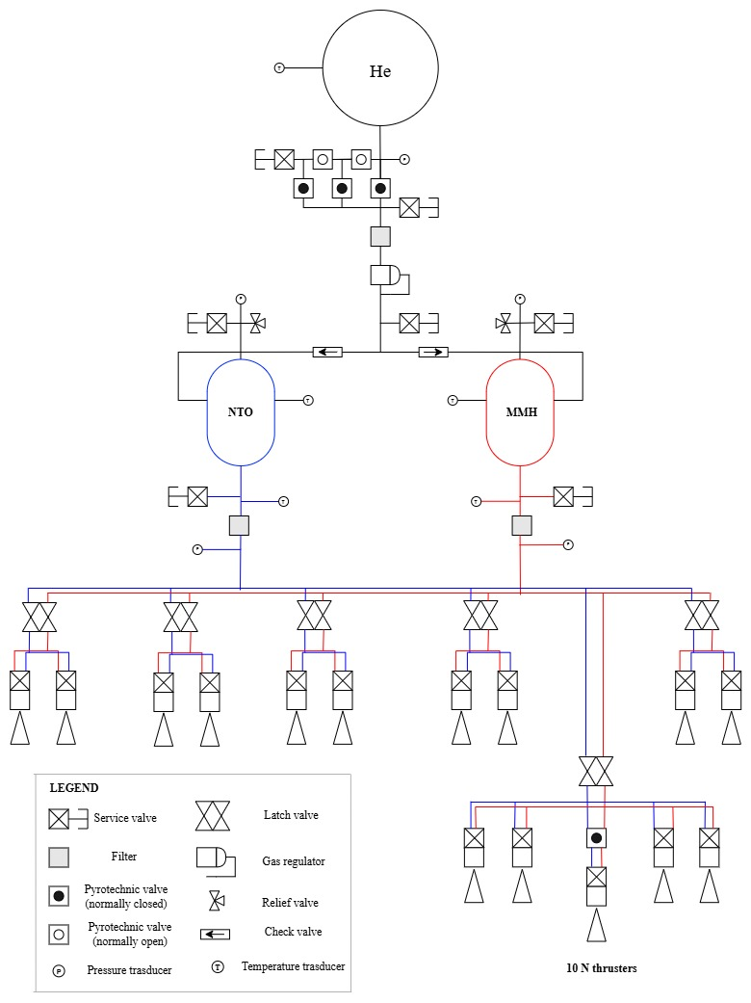
Final Baseline Design – PS
BIPROPELLANT MMH + NTO
15 Ariane Group Bi-propellant thrusters with Dual seat valve
Pressure-fed with Helium
Tanks Material: Ti6Al4V
Tanks Shape: Cylinder + Hemispherical Caps
Pressurant Tank Shape: Spherical
6 thrusters ADCS: Orbit Control, SK, T&G, Slew, De-Tumbling

Slide 30
Final Baseline Design – PS
BIPROPELLANT MMH + NTO
15 Ariane Group Bi-propellant thrusters with Dual seat valve
Pressure-fed with Helium
Tanks Material: Ti6Al4V
Tanks Shape: Cylinder + Hemispherical Caps
Pressurant Tank Shape: Spherical
5 thrusters PRIMARY PS (SR-01)

Slide 31
Final Baseline Design – PS
BIPROPELLANT MMH + NTO
15 Ariane Group Bi-propellant thrusters with Dual seat valve
Pressure-fed with Helium
Tanks Material: Ti6Al4V
Tanks Shape: Cylinder + Hemispherical Caps
Pressurant Tank Shape: Spherical
4 thrusters shared ADCS – PRIMARY PS

Slide 32
Final Baseline Design – PS
BIPROPELLANT MMH + NTO
15 Ariane Group Bi-propellant thrusters with Dual seat valve
Pressure-fed with Helium
Tanks Material: Ti6Al4V
Tanks Shape: Cylinder + Hemispherical Caps
Pressurant Tank Shape: Spherical
Inputs:
ΔV [m/s] = 2581
Choice:
Pc [bar] = 9
Isp [s] = 292
O/F = 1.67

Slide 33
Results – PS
Feature | Value
Propellant Mass [kg] | 2065.90
Pressurant Mass [kg] | 9.03
Fuel Tank Volume [m³] | 0.973
Oxidizer Tank Volume [m³] | 0.973
Pressurant Tank Volume [m³] | 0.278
Inert Mass of the PS [kg] | 98.45
Outputs:
Overall compact system
Single failure tolerant
Low power budget

Slide 34
Communication & On Board Data Handling Lorenzo Cesarini Gaetano Vitello

Slide 35
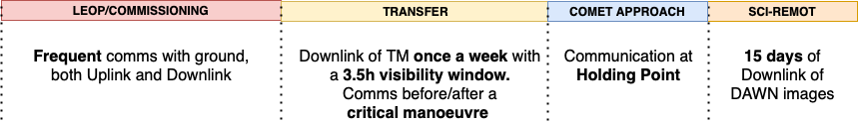
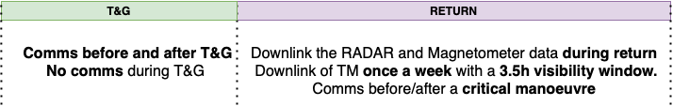
Communication Strategy – COMMS

Slide 36
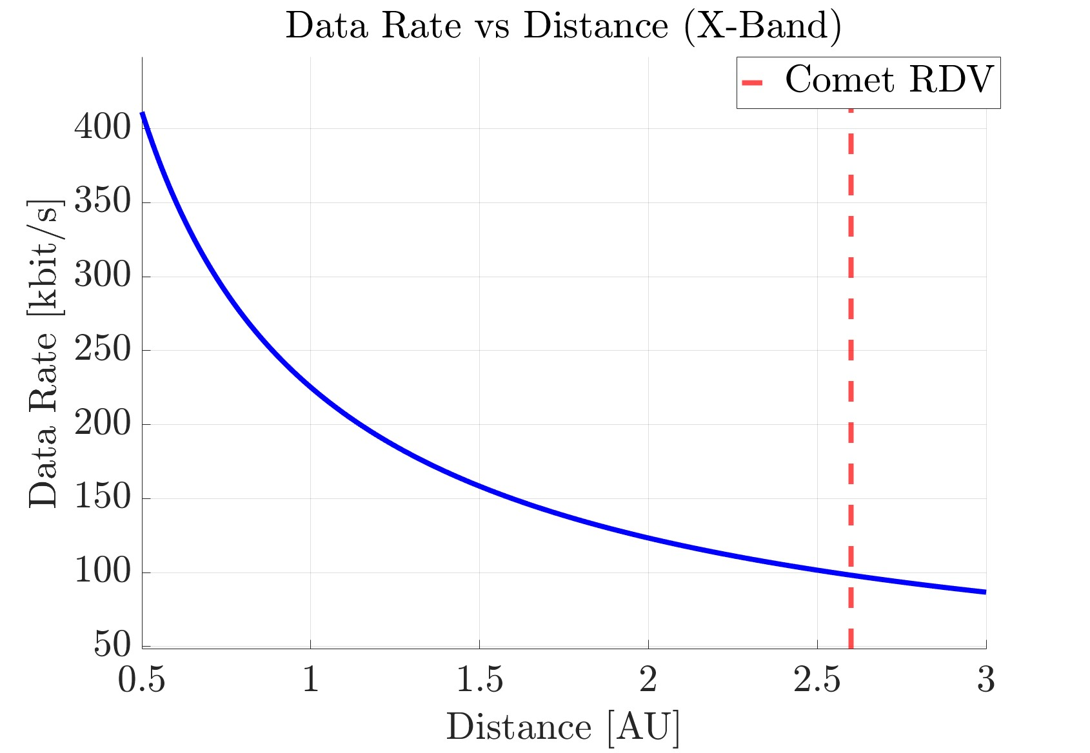
Analysis and Trade-offs – COMMS
Ground network:
ESA Core Network
- LEOP/Commissioning
- Close-to-Earth OPS
NASA DSN
Data Rate vs Distance (HGA):
Phase: Transfer
Distance: 4 [AU]
Data Rate: 10 [kbit/s]
Phase: Science
Distance: 2.6 [AU]
Data Rate: 100 [kbit/s]

Slide 37
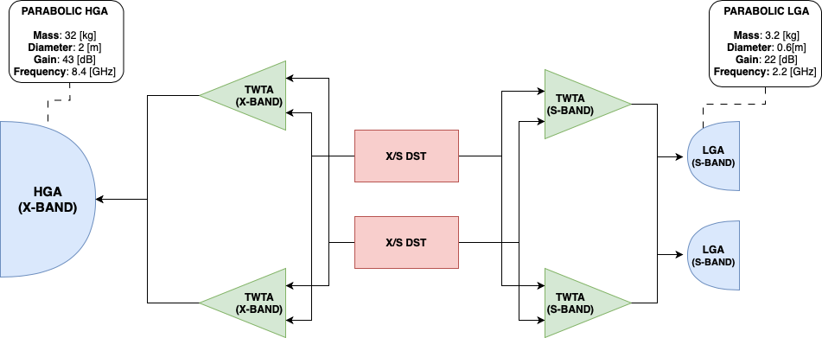
Final Baseline Design – COMMS

Slide 38
Requirements and Assumptions – OBDH
ID
SR-01 | The system shall be single-failure-tolerant
MR-08 | The total mission lifetime shall be at least 8 years
Assumptions
Main OBC shall be sized to store all Payload data (20 GB)
OBDH shall be sized to withstand total radiation dose absorbed during mission
Main OBC shall be sized for image processing
Main OBC Sizing Results
RAM [Mb] | ROM[Mb] | Mass Memory [GB]
2.33 | 4.34 | 20

Slide 39
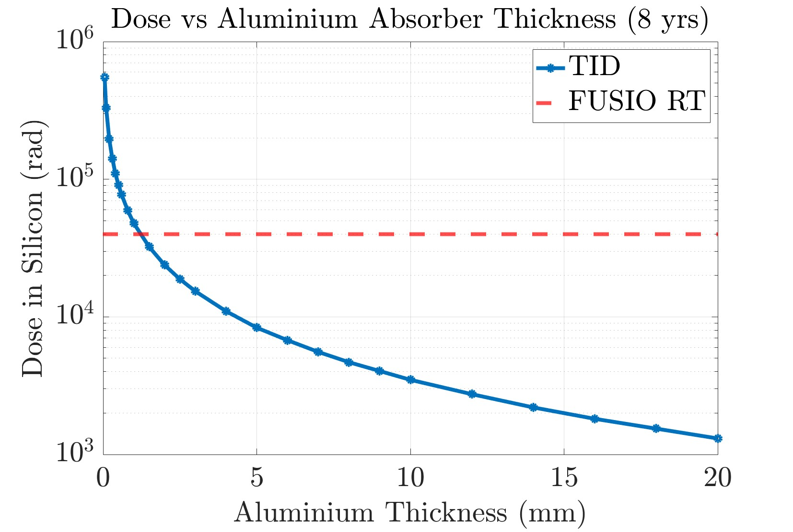
Analysis and Trade-offs – OBDH
TID Analysis performed using Spenvis
10⁶ rad absorbed over a 8yr mission at a distance of 1AU
FUSIO RT (Main OBC) tested for 50krad
2mm Al schielding around OBC

Slide 40
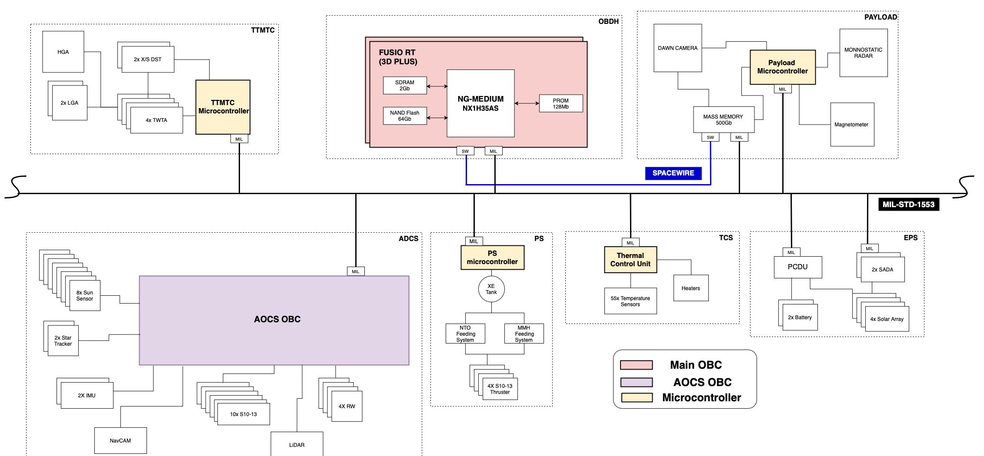
Final Baseline Design – OBDH

Slide 41
Electrical Power System Cecilia Calegari Giuseppe Brentino

Slide 42
Requirements and Assumptions – EPS
ID | Requirements
SR-01 | The system shall be single-failure-tolerant
MR-05 | The mission shall be compatible with a European launch vehicle
Assumptions:
The launcher will provide all the electrical power until separation
The solar array will always point toward the sun with an accuracy of 20 degrees.
Negligible eclipse time

Slide 43
Analysis and Trade-offs – EPS
Power generation:
Solar array: TJ GaAs by Azurspace, good compromise between cost and efficiency
RTG: 50% mass savings with respect to PV + batteries, but it is not compatible with Ariane 6
Batteries:
Li-Ion cells to reduce the mass
The touch and go maneuver will be performed on battery power, in order to reduce structural loads on the solar arrays
Power distribution:
Peak Power Tracking with an unregulated bus at 28V in accordance with the literature

Slide 44
Final Baseline Design – EPS
Solar arrays
Area [m^2] | 53.4
Mass [kg] | 267
Nseries | 13
Nparallel | 1226
Batteries
Capacity [W-hr] | 8100
Mass [kg] | 70
Nseries | 8
Nparallel | 30
Sizing case:
Phase: Telecom (low power)
Power required: 626 W
Max Sun distance: 4.6 AU
Specific power available: 13 W/m^2
Sizing case:
Survival in Safe mode for 12 hours @4.6 AU

Slide 45
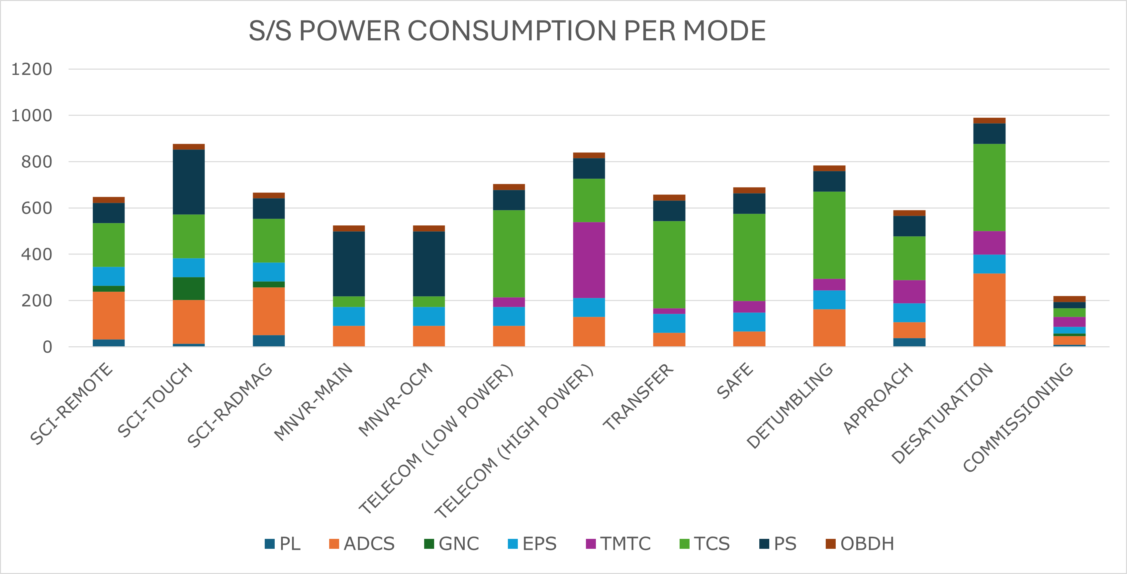
Power budget

Slide 46
Thermal Control Luca Frassinella Edoardo Mensi Weingrill Filippo Resta

Slide 47
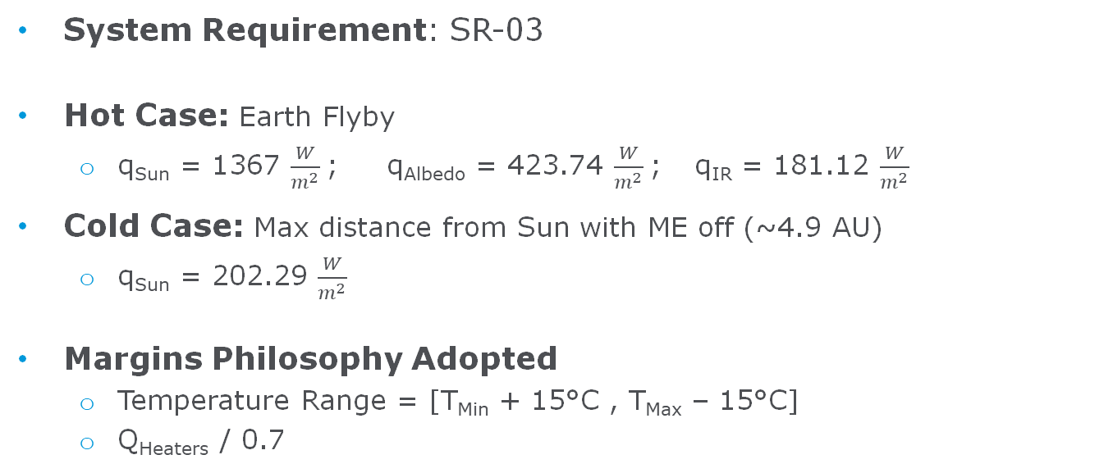
Requirements and Assumptions – TCS
System Requirement: SR-03
Hot Case: Earth Flyby
q_{Sun} = 1367 $\frac{W}{m^{2}}$; q_{Albedo} = 423.74 $\frac{W}{m^{2}}$; q_{IR} = 181.12 $\frac{W}{m^{2}}$
Cold Case: Max distance from Sun with ME off (~4.9 AU)
q_{Sun} = 202.29 $\frac{W}{m^{2}}$
Margins Philosophy Adopted
Temperature Range = [T_{Min} + 15°C , T_{Max} – 15°C]
Q_{Heaters} / 0.7

Slide 48
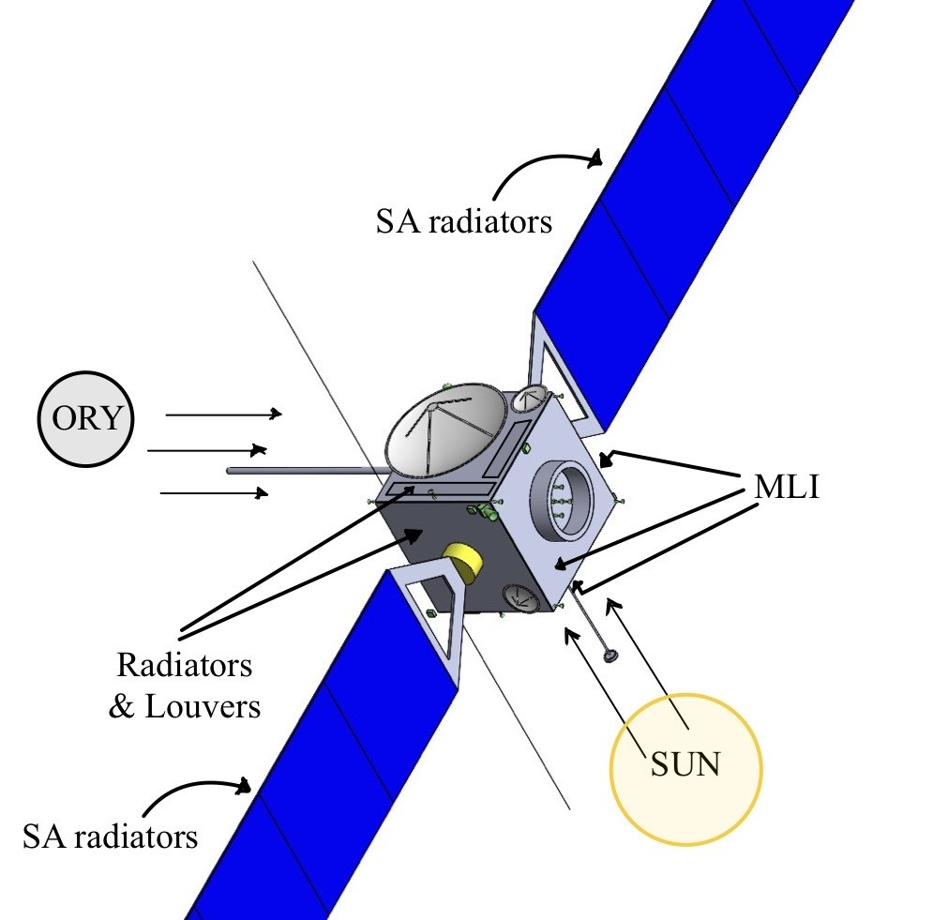
Analysis and Trade-offs – TCS
Subsystem architecture:
Radiators with thermal louvers:
Surface 3, 5, 6
Solar arrays
MLI on all external surfaces where free
Heaters on the critical components, mainly on batteries, tanks and P/L
Coatings:
Black paint for internal surfaces
White paint for HGA

Slide 49
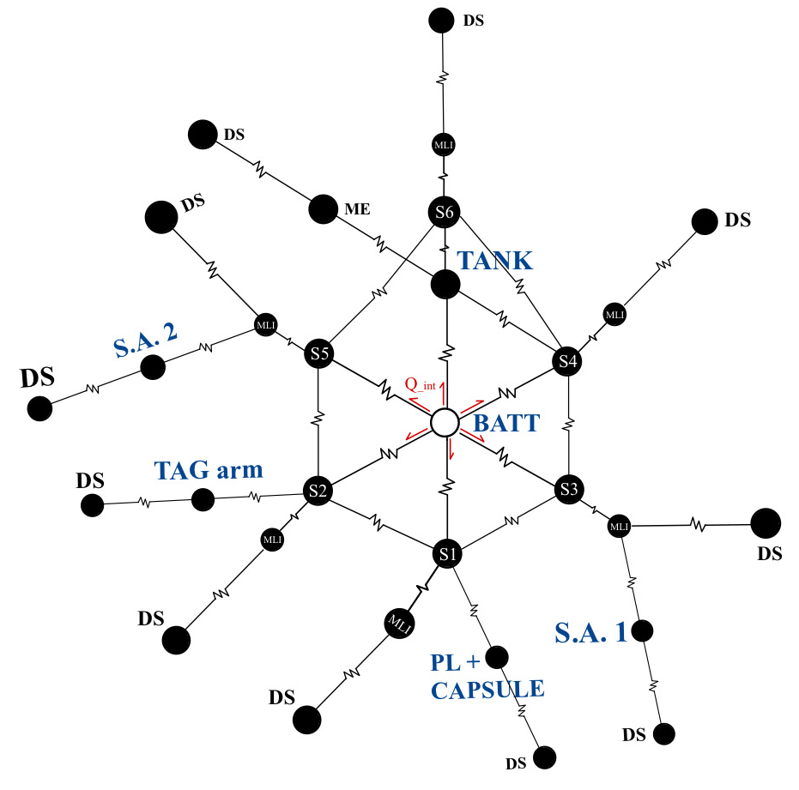
Analysis and Trade-offs – TCS
Approach:
Multi-Node Analysis
20 Nodes
External surfaces
External MLI layers
P/L, TAG arm, batteries, tank, SAs, main engine, radiators
Assumptions:
No radiative heat transfer between the panels
Unique node containing all the tanks, considering the most stringent temperature range
No transient analysis

Slide 50
Final Baseline Design – TCS
TEMPERATURE [°C]
 | HOT CASE | COLD CASE | Temperature Ranges [°C]
 | Fly-By at Earth | Comet Approach | T_{min} | T_{min.MM}* | T_{max} | T_{max.MM}*
SA1 | 51.8 | -117.4 | -150 | -135 | 150 | 135
SA2 | 51.8 | -117.4 | -150 | -135 | 150 | 135
TAG | 63.1 | -92.9 | -125 | -85 | 100 | 85
PL | 3.2 | -52.7 | -50 | -35 | 50 | 35
BATT | 30.9 | 13.8 | 0 | 15 | 35 | 20
TANK | 22.5 | 2.3 | 0 | 15 | 40 | 25
Final Architecture
Radiators Surface with Louvers (Arrays excluded) [m²] | 11.9
N.of Heaters | 20
* Margined according to the margin philosophy

Slide 51
Final Baseline Design – TCS

Slide 52
Configuration Giacomo Burlando Tommaso Cesarini

Slide 53
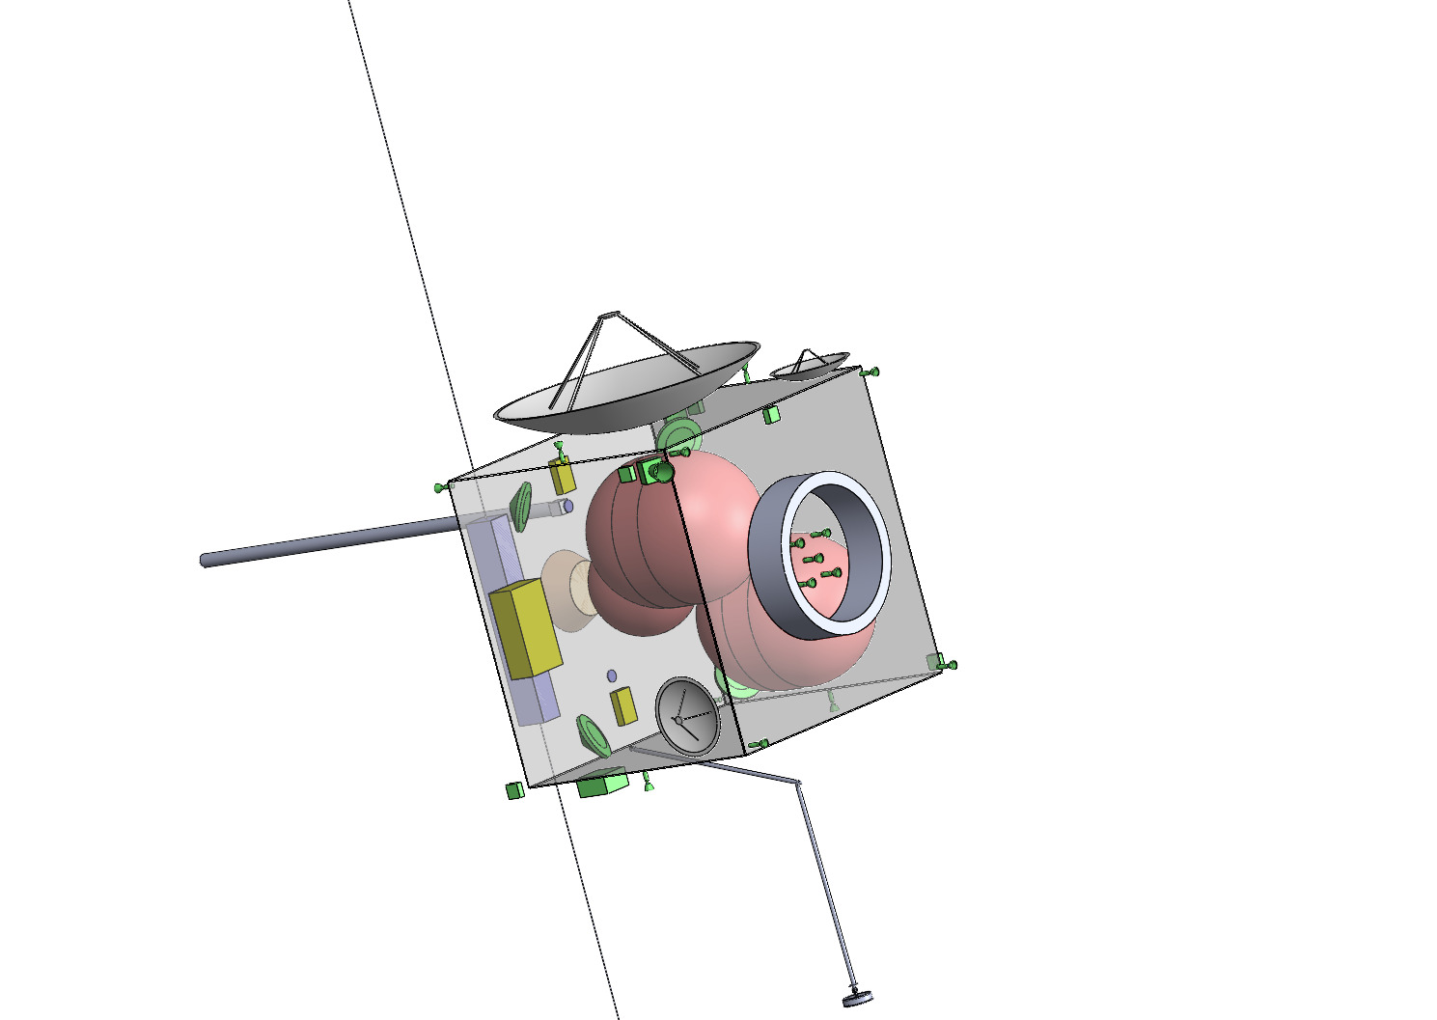

Configuration
Body | 2.3 x 2.3 x 2.1 m
Single solar array | 9.45 x 2.55 m
INTERNAL and EXTERNAL configuration
HGA
Radar
Tanks
Boom with magnetometer
LGA
Thrusters
Robotic arm
Sample return capsule
Adapter

Slide 54
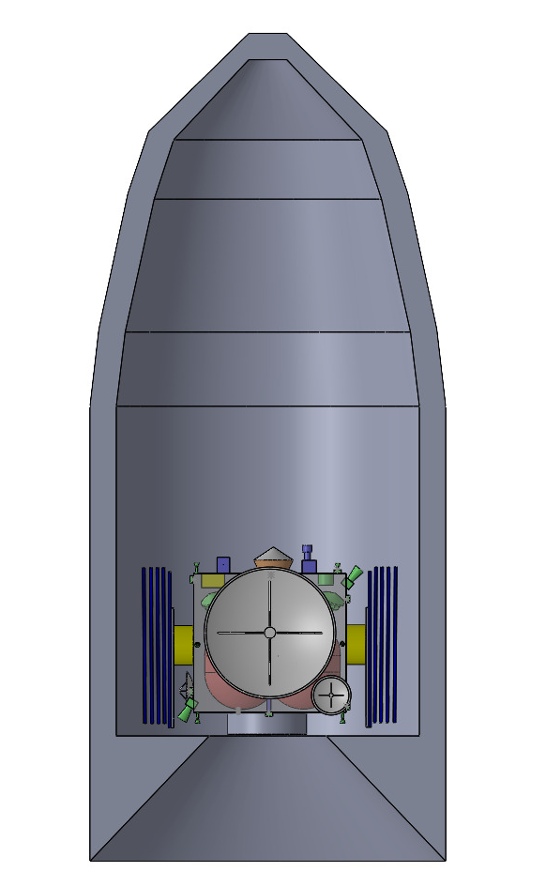
Configuration
Stowed conf. | 3.82 x 3.05 x 2.92 m
Fairing (Ø, H) | 5.4 x 20 m
Fairing envelope Ariane 64 with DORY

Slide 55
Structure Riccardo Galvani Mattia Sala Riccardo Caliri

Slide 56
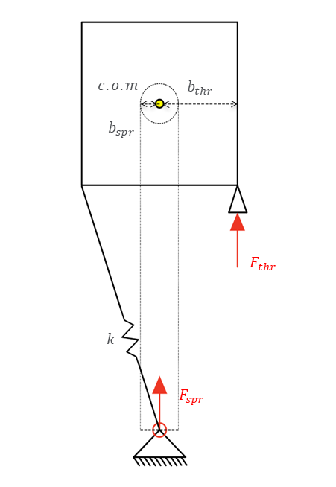
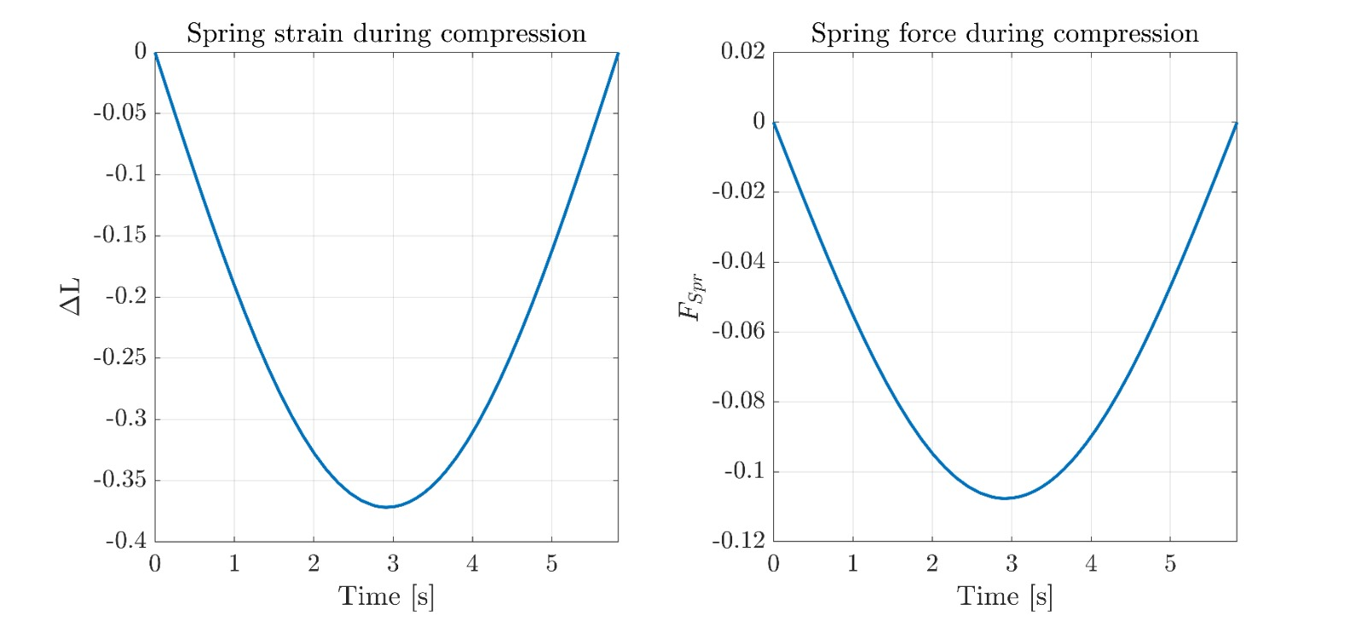
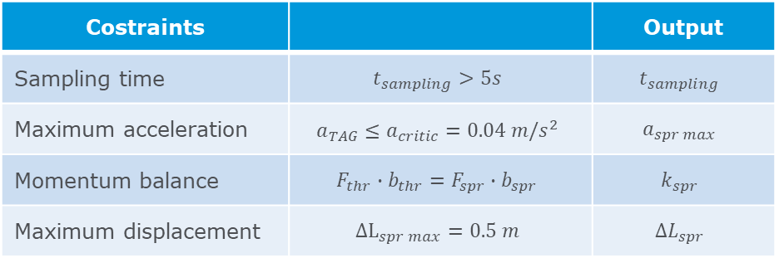
Structure - R.A.D.
Costraints |  | Output
Sampling time | $$t_{sampling}>5s$$ | $$t_{sampling}$$
Maximum acceleration | $$a_{TAG}≤a_{critic}=0.04 m/s^{2}$$ | $$a_{spr max}$$
Momentum balance | $$F_{thr}∙b_{thr}=F_{spr}∙b_{spr}$$ | $$k_{spr}$$
Maximum displacement | $${ΔL}_{spr max}=0.5 m$$ | $$ΔL_{spr}$$
Notes:
In this phase of the study, we defined the design constraints for the robotic arm during a touch-and-go maneuver. These constraints directly influence the selection of key parameters, summarized as follows:
Sampling time: To ensure the minimum mass of sample required in the mission objective a minimum sampling time of 5 seconds was stated based on the experiment performed during the osirix rex mission preparation.
Maximum acceleration: The spacecraft’s structural limits, particularly the flexibility of the solar panels, led us to set a maximum allowable acceleration of 0.04 m/s².
Momentum balance: To account for potential offsets in the center of mass and resulting torques, we used a moment equilibrium equation involving the spring and thrusters. From this balance, we derived the required spring stiffness that keeps the attitude disturbance within the correction capacity of the 10 N thrusters.
Maximum displacement: The arm’s spring displacement was limited to 0.5 meters. This constraint, related to the overall size of the mechanism, ensures that the energy stored and released remains within controlled bounds.
Each constraint leads to a corresponding design output: sampling time, maximum arm-induced acceleration, spring stiffness, and maximum displacement. Together, they define a robotic system that is stable, structurally compatible, and capable of performing precise touch-and-go operations in space

Slide 57
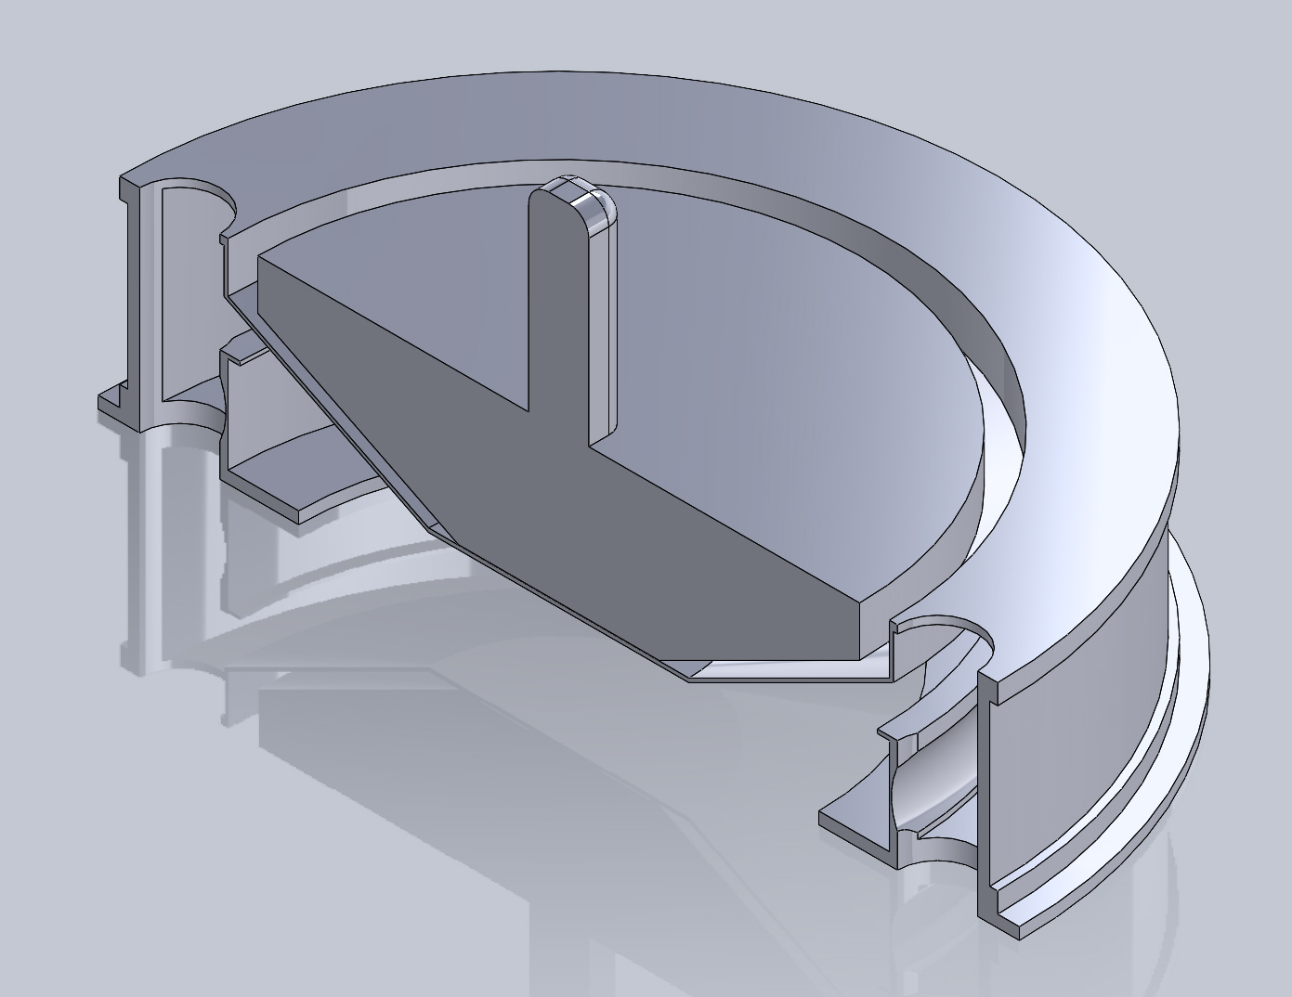

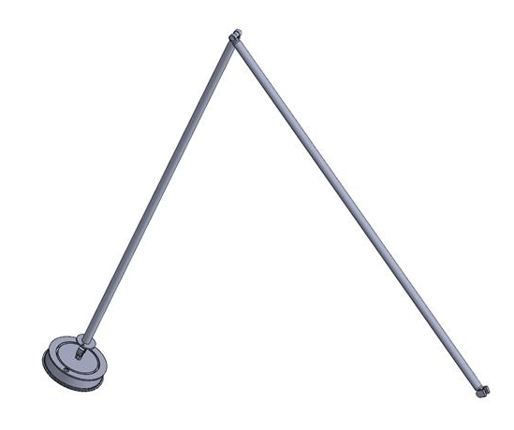


Structure: TAGSAM & Robotic Arm
(Heritage: OSIRIS-REx)
HOLES FOR N₂ FLOW
Description | Data
Base diameter | 0.23 m
Height | 0.053 m
Material selected | Al 7075
Dry mass to store in return capsule | 0.91 kg
Allowable sample volume | 0.374 L
Arm full extention | 3.4 m
Arm diameter | 0.006 m (TBC)
DETACHABLE COMPONENT
38 μm OPENINGS
COLLECTION RESERVOIR
COLLECTION HEAD
ELBOW
Extensive IRAD-supported LM testing
Test results fulfil collection requirements
Shoulder and Elbow EMs to size
Wrist U-joint to adapt to the ground
N₂ BOTTLES
WRIST
SHOULDER
SHOULDER

Slide 58
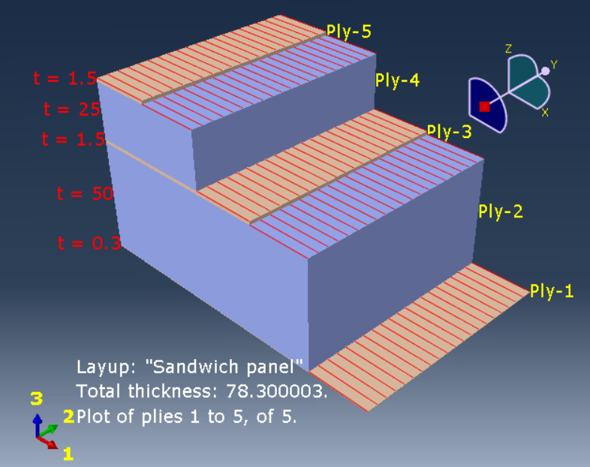

Structure: Modal Analysis
Launcher compliance | Value
Min. axial natural frequency | 20 Hz
Min. lateral natural frequency | 6 Hz
Min. ax. obtained | 29 Hz
Min. lat. obtaned | 13 Hz
Zone | Selected materials
Skin e core | Aluminum and honeycomb composite layup.

Slide 59
Mass budget
Subsystem | Mass with DMMs[kg]
P/L | 43.03
ADCS | 50.72
GNC | 33.47
EPS | 413.88
TTMTC | 68.88
TCS | 11.34
PS | 98.45
OBDH | 1.20
CAPSULE | 27.3
STRUCTURES | 420
Dry Mass (+20%) | 1497.91
Wet Mass | 3563.81
Launch Mass | 3643.81
- Design Maturity Margins
for subsystems are applied in compliance with ECSS standards.
- Mass currently not compliant with Ariane 64 C3 capabilities, but addressable in further iterations.

Slide 60
Cost Gaetano Vitello

Slide 61
Final Baseline Design – COST
System activities cost:
Management
Engineering
Product assurance
AIVT
Planetary Protection
Facility
Operation:
DSN Ground Station
MOC, SOC
Payload Instrumentation.
Total no margin: | 636.93 M€
Total + 31% risk margin: | 834.43 M€

Slide 62
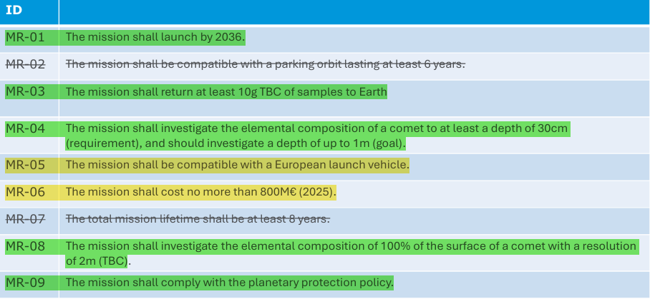
Mission Requirements Overview

Slide 63
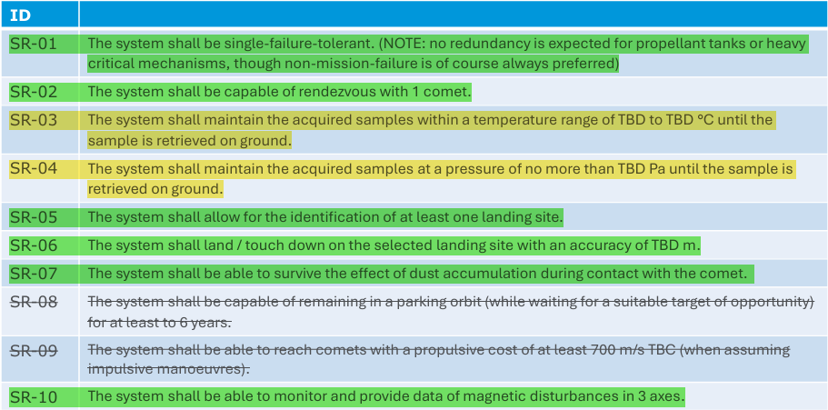
System Requirements Overview

Slide 64
Conclusions
The mission is deemed feasible, and can go through further studies to address open points and criticalities
Open points
Ariane 64 currently insufficient
Further design iteration needed on all subsystems
If an European launcher is not selected, RTGs can be evaluated as power source alternative
Re-iterate mission design with Electric Propulsion
Samples management (Pressure, Temperature)

Slide 65
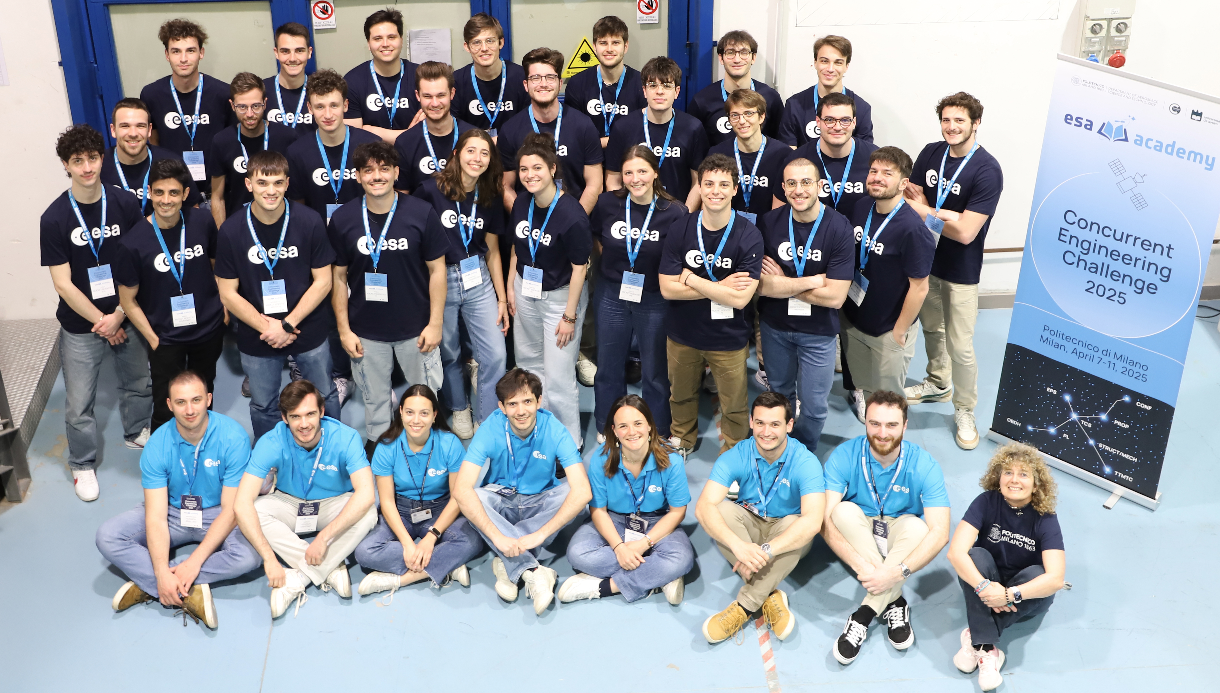

Slide 66
Open Points – Payload
Mass Spectrometer
Neutron Detector
Camera imaging optimization

Slide 67
Backup Slide – Mission Analysis

Slide 68
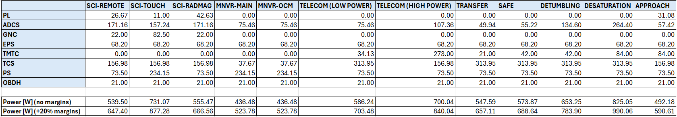
EPS: Power budget

Slide 69
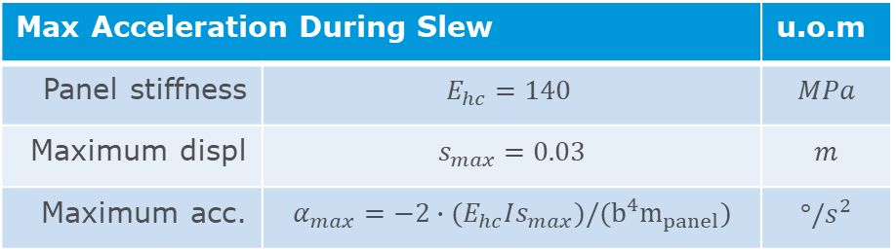
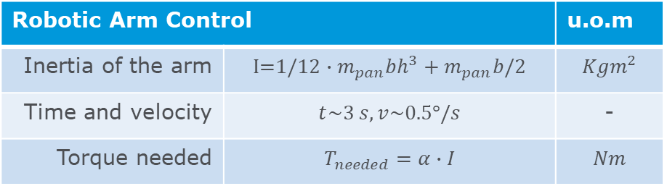
Structure: Backup_slide_RA_aS.
Robotic Arm Control |  | u.o.m
Inertia of the arm | $$\text{I}\text{=1/12}∙m_{pan}bh^{3}+m_{pan}b/2$$ | $$Kgm^{2}$$
Time and velocity | $$t\sim 3 s, v\sim 0.5°/s$$ | -
Torque needed | $$T_{needed}=α∙I$$ | $$Nm$$
Max Acceleration During Slew |  | u.o.m
Panel stiffness | $$E_{hc}=140$$ | $$MPa$$
Maximum displ | $$s_{max}=0.03$$ | $$m$$
Maximum acc. | $$α_{max}=−2∙(E_{hc}Is_{max})/(b^{4}m_{panel})$$ | $$°/s^{2}$$

Slide 70
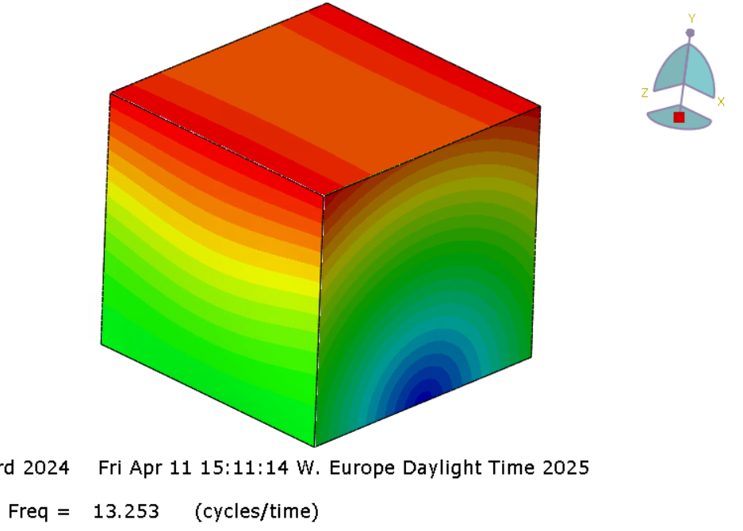
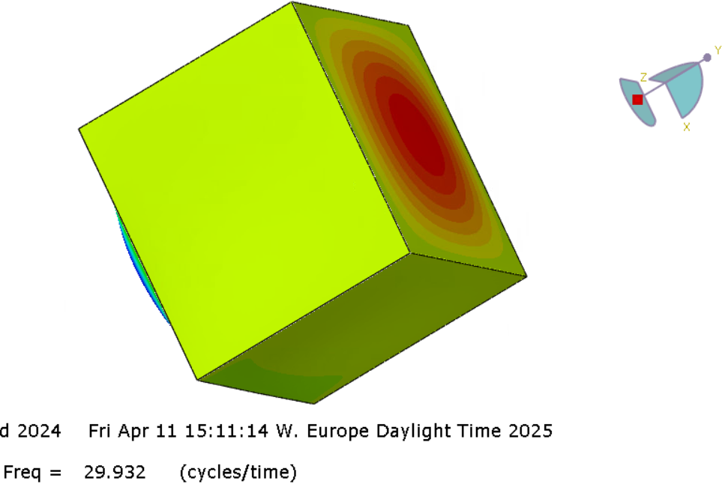
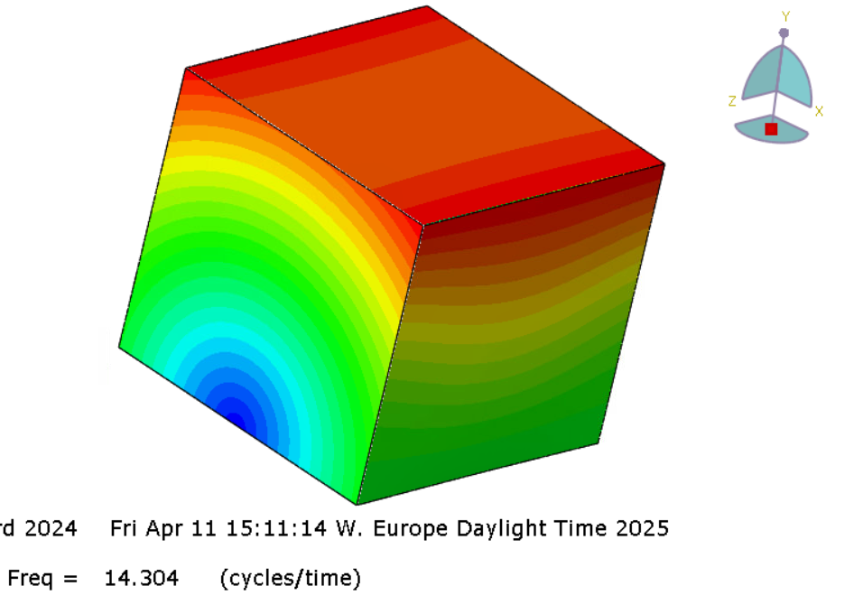
Structure: Modal Analysis

